Slide 1
Quantum Telepathy
or
Quantum Nonlocality

Slide 2
“The really remarkable thing about our quantum world is the existence of nonlocal correlations – correlations between events at separate locations – that can’t be explained by either of the two sorts of explanation we are familiar with in classical physics or in everyday life: a direct causal connection in which information is transmitted from one event to the other by some physical system moving continuously at finite speed between the correlated events, or a common cause that is the source of the same information transmitted to the correlated events.”
Jeffrey Bub, Bananaworld – Quantum Mechanics for Primates.
Oxford, UK: Oxford University Press, 2016 (page 43).

Slide 3
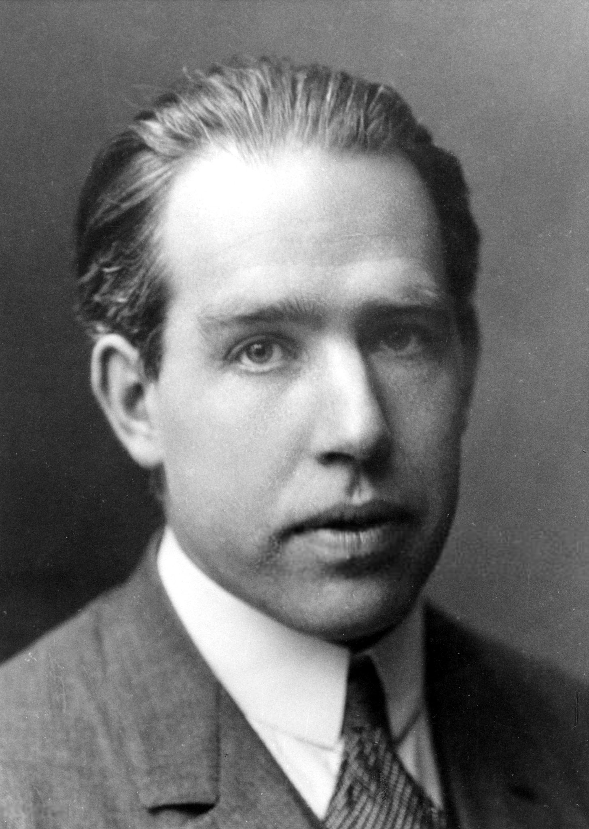
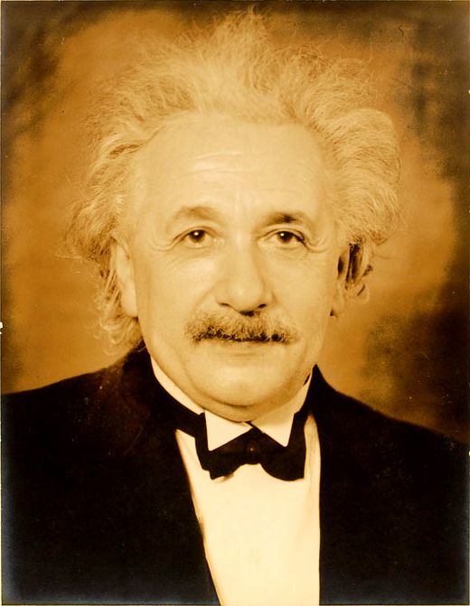
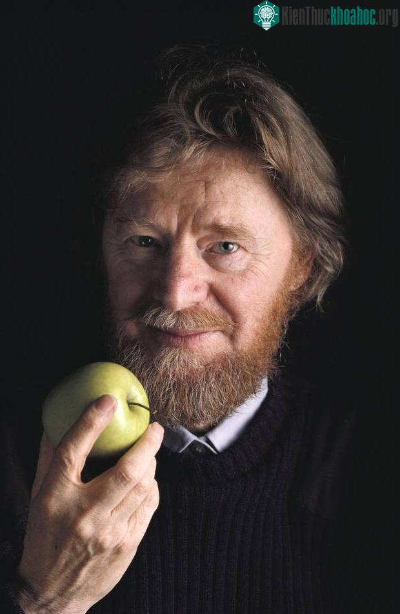
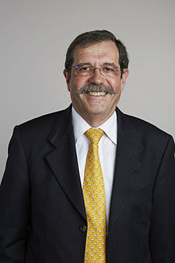
Niels Henrik David Bohr (1885 – 1962)
Albert Einstein (1879 – 1955)
John Stewart Bell (1928 – 1990)
Alain Aspect (1947 – )

Slide 4
“Einstein sought both realism and locality in physical theory.”
Gregg Jaeger, Entanglement, Information, and The Interpretation of Quantum Mechanics.
Berlin: Springer-Verlag, 2009 (page 58).

Slide 5
Alice and Bob are going to put on an amazing exhibition in a theater. They are in two separate cubicles on the stage. However, they cannot communicate with one another in any way.
At regular intervals, two people from the audience each give Alice and Bob a card with a 1, a 2 or a 3 printed on it.
At this point, Alice and Bob are asked to write YES or NO, by their own choice, on the cards they have received. Neither Alice nor Bob do know the number the other one has been given.
What makes the show interesting is that, although the responses that Alice and Bob write down on their cards are completely unpredictable (with a random sequence of YESes and NOs), every time they are handed cards with the same number on them, they write down the same answer (both writing YES or both writing NO).
Therefore, after a fair number of runs, Alice and Bob announce they are telepathic. They also say they are ready to give repeated performances of the feat.

Slide 6
YES
NO
YES
NO
Alice
Bob
1
2
3
1
2
3

Slide 7
EPR
EPR is an acronym of Einstein-Podolsky-Rosen as expressed in the famous article:
Albert Einstein, Boris Podolsky, and Nathan Rosen,
“Can Quantum-Mechanical Description of Reality be Considered Complete?”
Physical Review, Vol. 47, No. 10, pp. 777-780, 1935

Slide 8
The EPR argument

Slide 9
In the audience there are skeptical people (as EPR) who are not convinced that Alice and Bob are telepathic. Indeed, they have a very simple explanation: they assume that, before the performance, Alice and Bob have agreed on what answers they will give according to the numbers on the cards they have received. This is a local strategy.
An example of that agreement is the following hidden instruction: YNY.
This instruction, YNY, means the following:
Answer Yes if the card number is 1;
Answer No if the card number is 2;
Answer Yes if the card number is 3.
There are, of course, 8 different instructions of this type: { YYY, YYN, YNY, YNN, NYY, NYN, NNY, NNN }. On the other hand, there are 9 different settings for the pair of numbers given to Alice and Bob: { 11, 12, 13, 21, 22, 23, 31, 32, 33 }.
However, to reproduce the statistics of their responses, they will have to change their pattern with every set of cards.

Slide 10
A run of this show is characterized, for example, by 21YN, meaning:
Alice received a card with number 2 and her answer was Yes;
Bob received a card with number 1 and his answer was No.
The claim of telepathy is now readily dispelled if there are hidden instruction sets:
A run 22YY is the result of any instruction from the set {YYY, YYN, NYY, NYN};
A run 33NN is the result of any instruction from the set {YYN, YNN, NYN, NNN};
A run 11YY is the result of any instruction from the set {YYY, YYN, YNY, YNN}.

Slide 11
The Bell argument

Slide 17
Quantum Mechanics
(QM)

Slide 18
“Once you accept the idea that polarized light consists of photons and that the latter are indivisible entities, physics cannot be the same. Chance must be elevated to the status of an essential feature of physical behavior.”
Asher Peres, Quantum Theory: Concepts and Methods. Dordrecht, The Netherlands: Kluwer Academic Publishers, 1995 (page 7).

Slide 19
“Don’t give up, until you are fully convinced that an instrument measuring the polarization parameters of a single photon cannot exist. The question “What is the polarization of that photon?” cannot be answered and has no meaning. A legitimate question, which can be answered experimentally (…) is whether or not a photon has a specified polarization.”
Asher Peres, Quantum Theory: Concepts and Methods. Dordrecht, The Netherlands: Kluwer Academic Publishers, 1995 (pages 9 – 10).

Slide 20
“In summary, while it is possible to measure with good accuracy the polarization parameters (…) of a classical electromagnetic wave which contains a huge number of photons, it is fundamentally impossible to measure those of a single photon of unknown origin.”
Asher Peres, Quantum Theory: Concepts and Methods. Dordrecht, The Netherlands: Kluwer Academic Publishers, 1995 (page 10).

Slide 29
Quantum Mechanics (QM)
According to QM, after comparing all the runs from both Alice and Bob, we get the two following rules:
Rule 1 – When the switches have the same (S) setting, the outcomes always agree: YY or NN.
Rule 2 – In all runs together, regardless of how the switches were set (S or D), there is an equal probability of agreeing outcomes: YY or NN.

Slide 30
Conclusion

Slide 32
Following EPR, the only rational way to explain the fact that, according to Rule 1, the outcomes always agree when the polarizers have the same orientation – to dispel the outrageous claim of telepathy between Alice and Bob – is to assume that each photon carries some (hidden) instruction to explain this amazing behavior.
However, according to Rule 2, QM predicts that the overall probability of agreement between Alice and Bob should be 50%, whereas – according to EPR – a local strategy, ruled through hidden instructions, would lead to a higher probability of, at least, 55.56%.
All experimental evidence corroborates QM and hence reveals the falsehood of the local strategy advocated by EPR.
The conclusion, forced upon us, is the following: although we cannot accept that Alice and Bob are telepathic, one should claim some form of quantum telepathy to account for this quantum nonlocality. This quantum telepathy is the result of entanglement.

Slide 33
“The obvious conclusion is as follows: Alice and Bob cannot have arranged anything beforehand. But the perfect concordance of their responses in all the cases where they were given cards with the same number admits of no explanation other than telepathy. In some mysterious way Alice and Bob manage to «communicate with each other» when they are given the same number.”
Giancarlo Ghirardi, Sneaking a Look at God’s Cards – Unraveling the Mysteries of Quantum Mechanics, Revised Edition.
Princeton, NJ: Princeton University Press, 2005 (page 233).

Slide 34
According to Einstein, this form of quantum telepathy should be regarded as
«spooky action at a distance»
which violated what he considered to be a fundamental principle for science:
Locality

Slide 35
“Nonlocality, an actual fact proven by experimental evidence that leaves no room for reasonable doubt, presents characteristics of such a peculiar kind as to keep it from being used to produce instantaneous effects between distant physical systems.”
Giancarlo Ghirardi, Sneaking a Look at God’s Cards – Unraveling the Mysteries of Quantum Mechanics, Revised Edition.
Princeton, NJ: Princeton University Press, 2005 (page 291).

Slide 36
«The state-vector is as complete a description of a system as it is possible to make. So it seems that in quantum mechanics, we can know everything about a composite system – everything there is to know, anyway – and still know nothing about its constituent parts. This is the true weirdness of entanglement, which so disturbed Einstein.»
Leonard Susskind & Art Friedman,
Quantum Mechanics – The Theoretical Minimum.
London, UK: Penguin Books, 2015 (page 175).

Slide 37
Quantum Contextuality
Quantum nonlocality is a special case of quantum contextuality.
Quantum contextuality states that measurements of quantum observables do not reveal pre-existing values.
The measurement result of an observable depends on the choice of the other commuting observables that belong to the same measurement context.
In fact, what has been called herein quantum telepathy is technically known as quantum pseudo-telepathy. The prefix pseudo stresses that exchange of information between the parties is not involved.
The Mermin-Peres magic square game is an example of quantum pseudo-telepathy.

Slide 38
REFERENCES
Giancarlo Ghirardi,
Sneaking a Look at God’s Cards – Unraveling the Mysteries of Quantum Mechanics, Revised Edition.
Princeton, NJ: Princeton University Press, 2005 (Chapter 10)
N. David Mermin,
Boojums All The Way Through – Communicating Science In a Prosaic Age.
New York, NY: Cambridge University Press, 1990.
(Chapter 12)

